Slide 1


Neural Operators – Basics, Fourier and Galerkin; Large Scale Surrogates
Pedro P Santos^{1,2}
¹Georgia Tech, School of Electrical Engineering, Atlanta, Georgia, USA.
²Georgia Tech – Emory University, Wallace H. Coulter Department of Biomedical Engineering,
Atlanta, Georgia, USA.
Notes:
Oxford

Slide 2
Presentation topics
This presentation is going to be divided into 8 sections:
My research background;
Definition of vector, function and operators;
Initial Neural Operator topologies;
10-minute Break!
Fourier Neural Operator;
Galerkin Transformer;
Potential future directions;
Large Scale Surrogates.

Slide 3
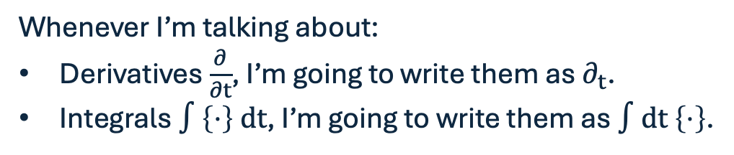
Notation
Whenever I’m talking about:
Derivatives $\frac{∂}{∂t}$, I’m going to write them as $∂_{t}$.
Integrals $∫\left\{⋅\right\} dt$, I’m going to write them as $∫dt \left\{⋅\right\}$.

Slide 4
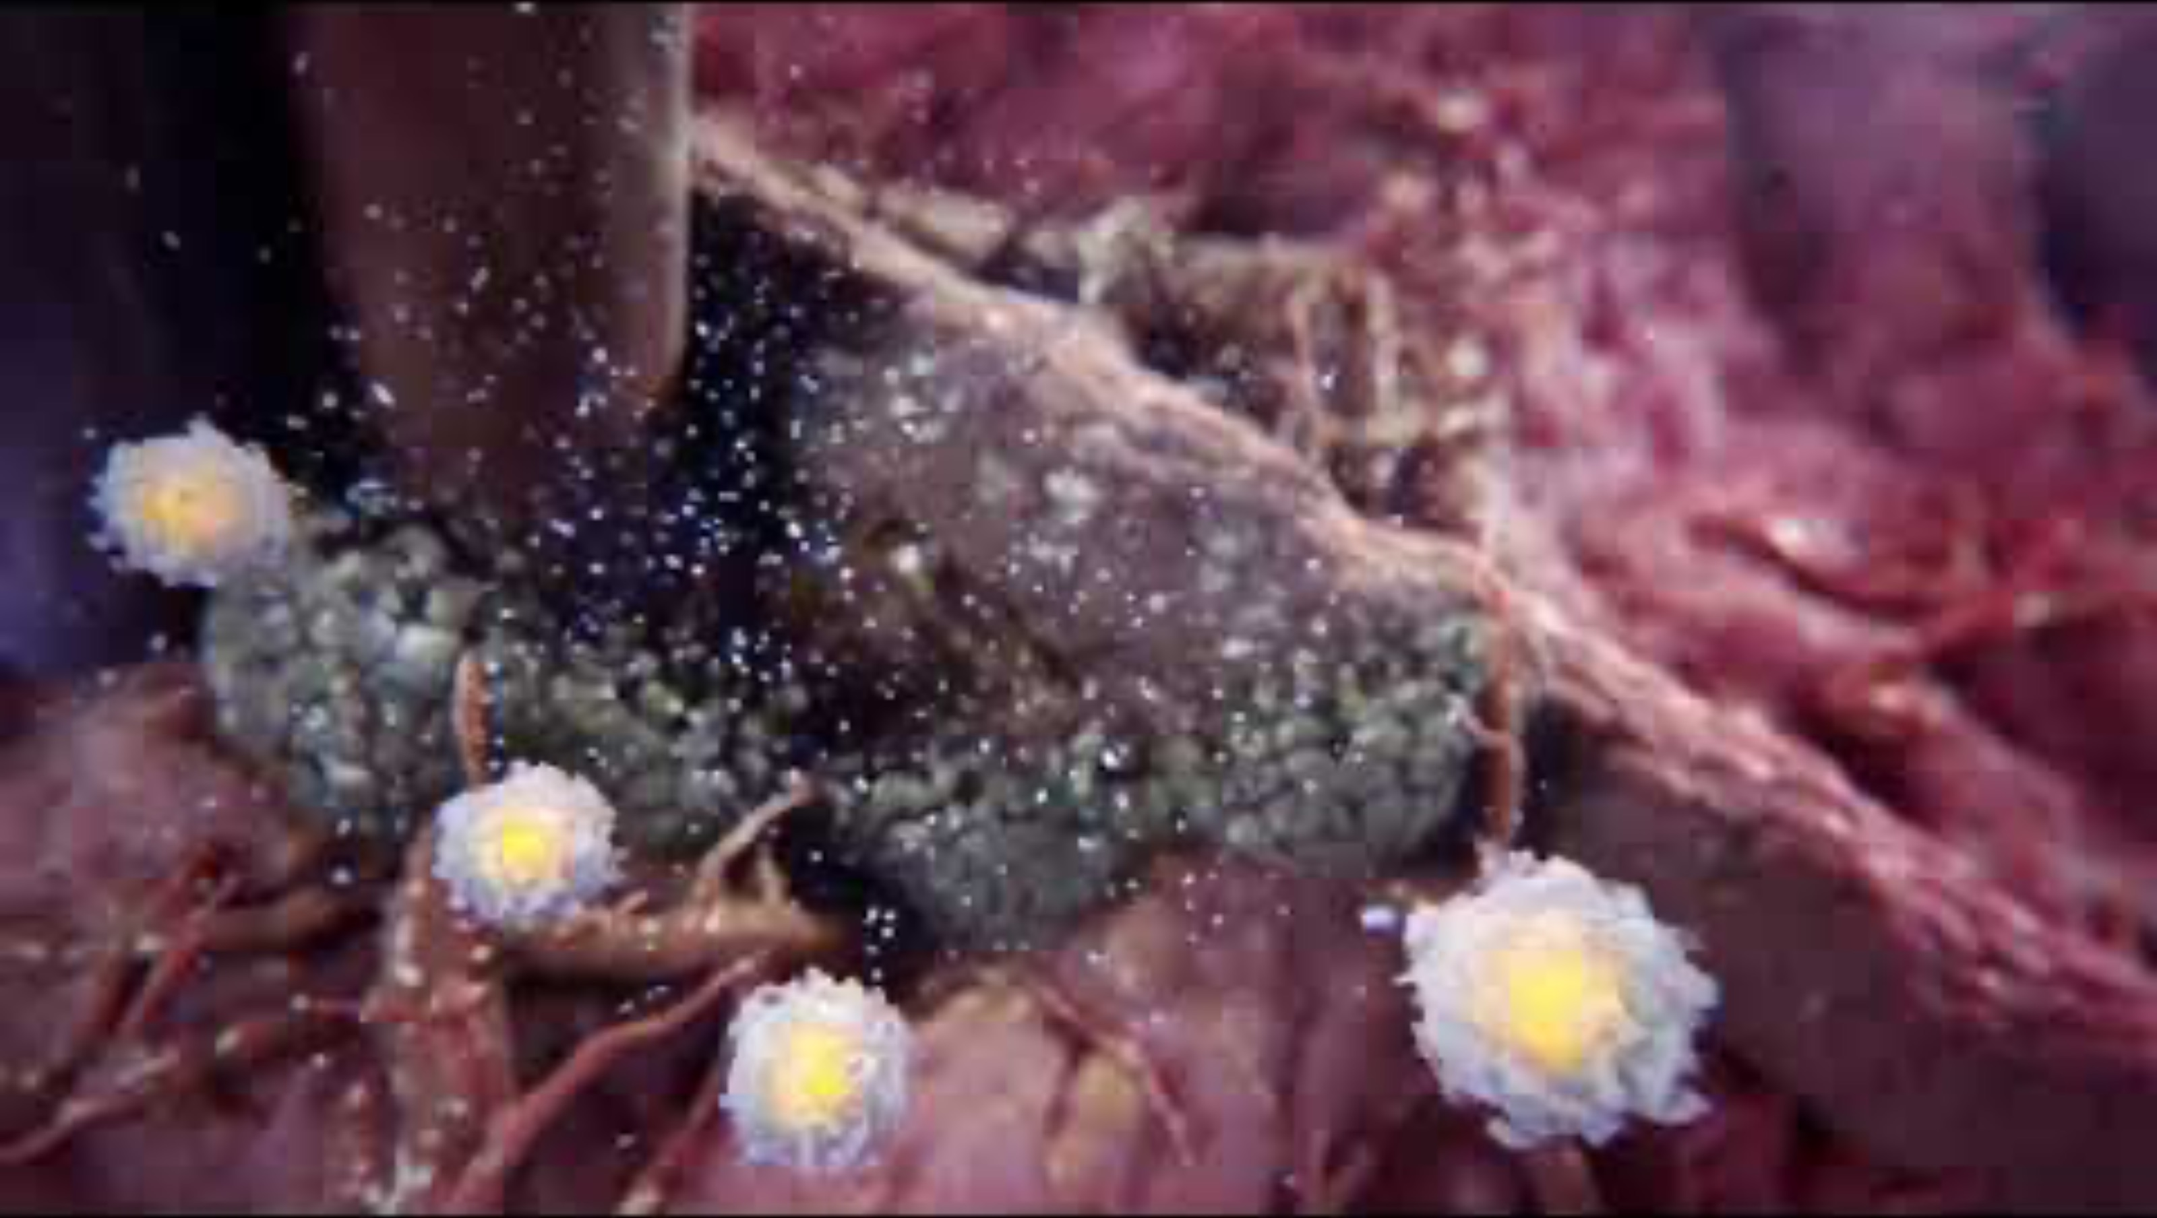
My research background
Electroporation: Application of electric fields to biological tissue, either for gene transfer (for vaccines or DNA transfer) or ablation (inducing cell death).

Slide 5
Two big problems to tackle
Two of the most prominent problems that we have are:
Temperature increase: When we apply electricity (i.e., energy) to a system, it will inevitably heat up due to the Joule Effect; this can be problematic for a variety of reasons.
Muscle contractions: All internal signaling is mediated by ions, and the application of an external electrical stimulus can (and will) disrupt these communications, leading to involuntary muscle contractions.

Slide 6
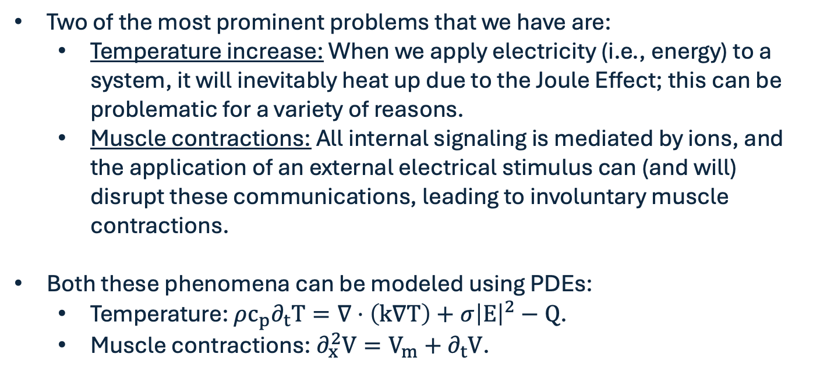
Two big problems to tackle
Two of the most prominent problems that we have are:
Temperature increase: When we apply electricity (i.e., energy) to a system, it will inevitably heat up due to the Joule Effect; this can be problematic for a variety of reasons.
Muscle contractions: All internal signaling is mediated by ions, and the application of an external electrical stimulus can (and will) disrupt these communications, leading to involuntary muscle contractions.
Both these phenomena can be modeled using PDEs:
Temperature: $ρc_{p}∂_{t}T=∇⋅\left(k∇T\right)+σ{\left|E\right|}^{2}−Q$.
Muscle contractions: $∂_{x}^{2}V=V_{m}+∂_{t}V$.

Slide 7
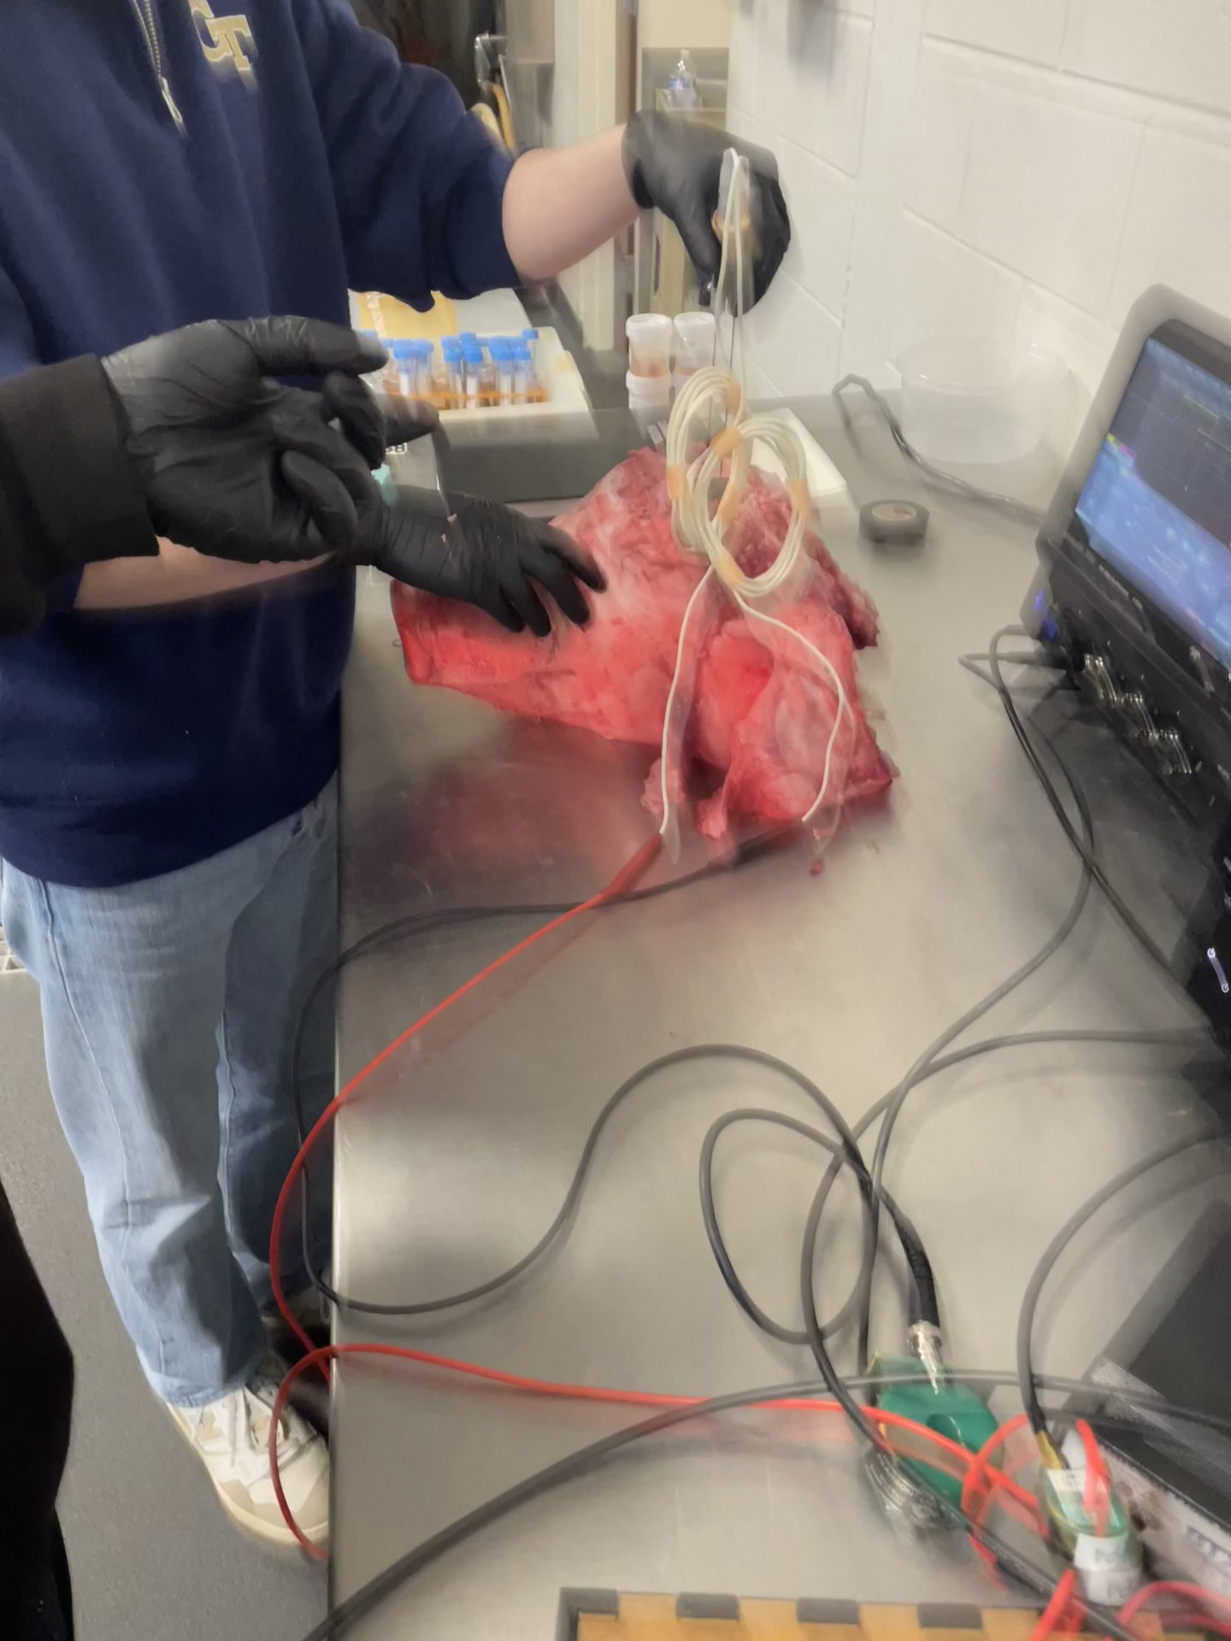
Two big problems to tackle

Slide 8
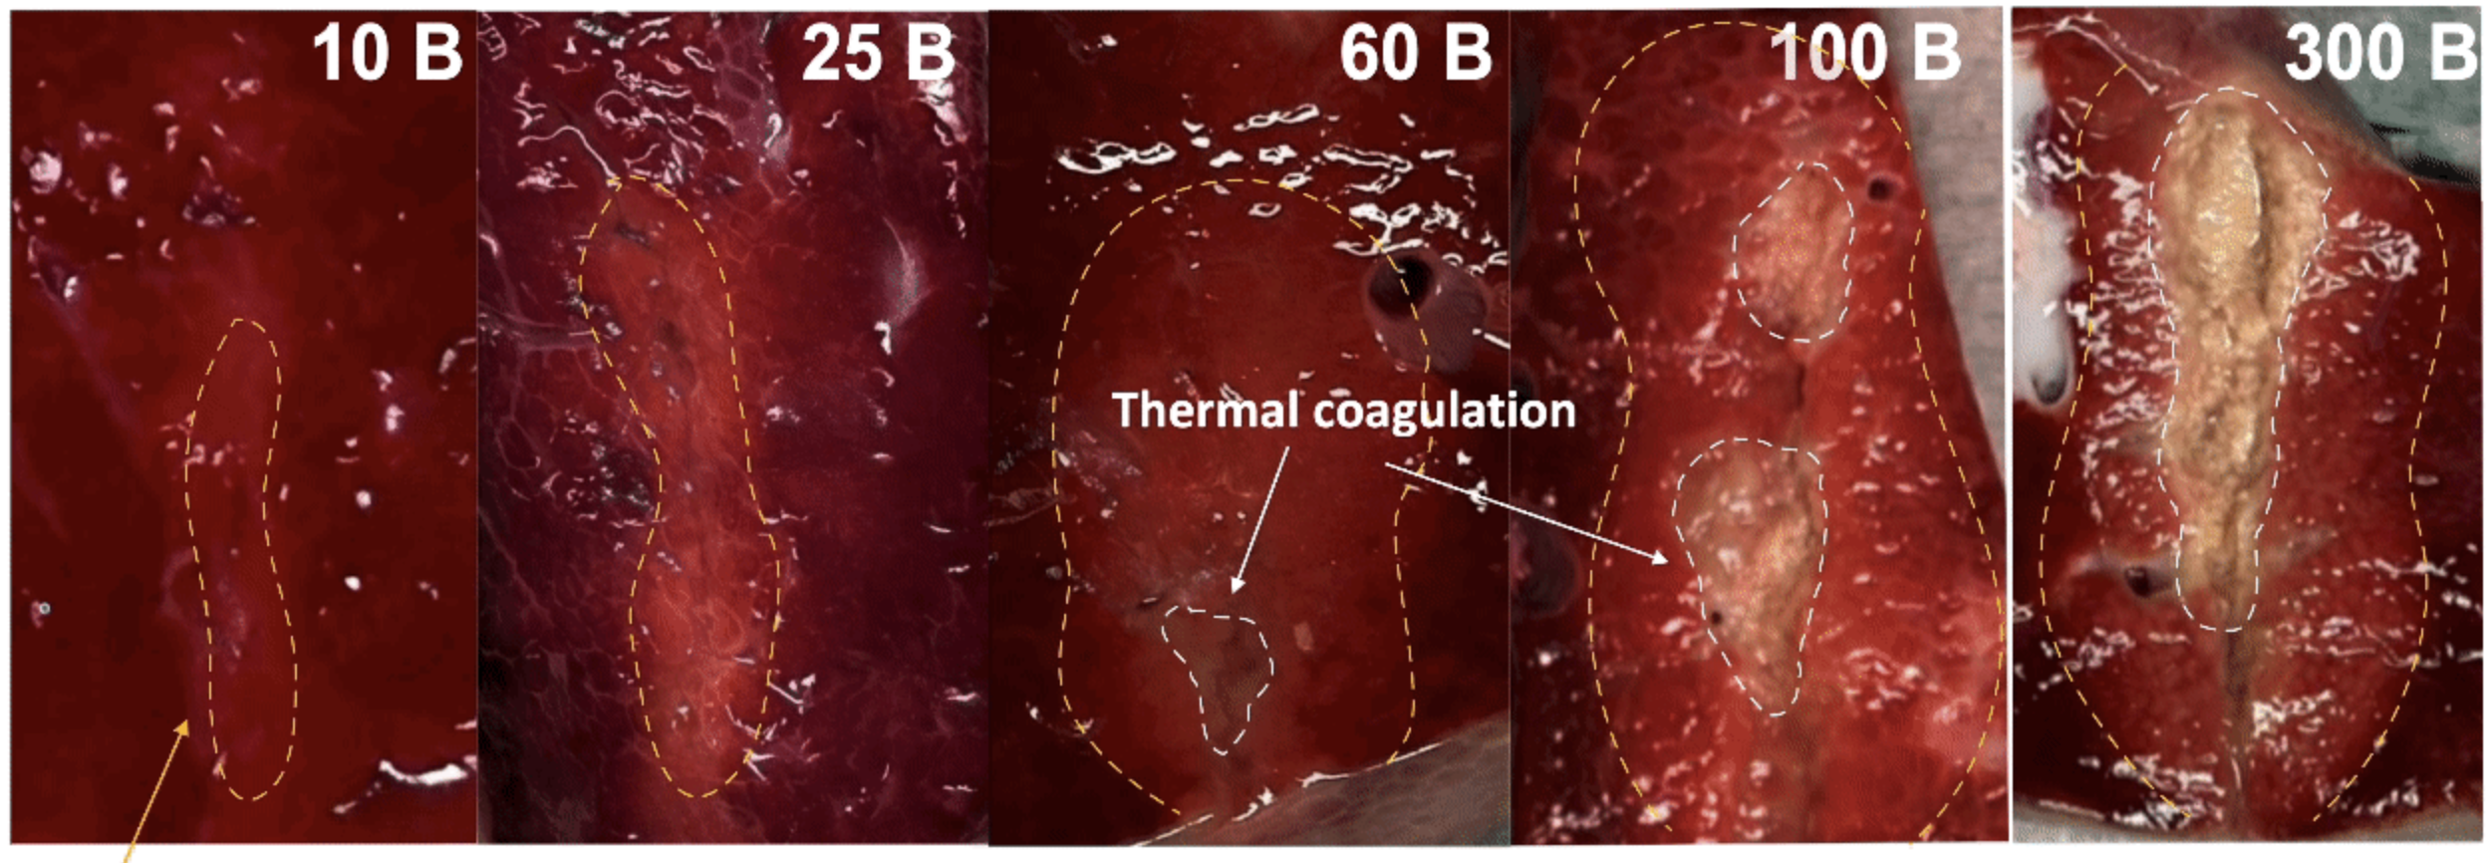
Two big problems to tackle
Ablation

Slide 9
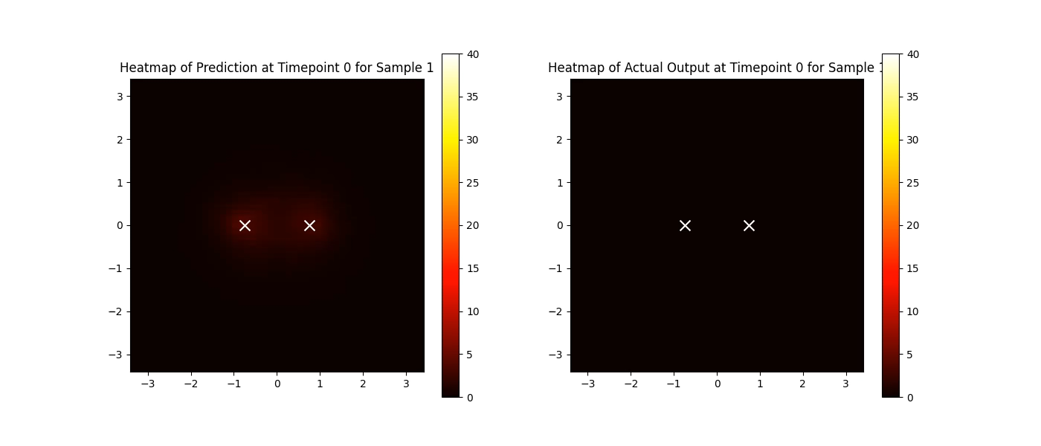
Our current solution

Slide 10
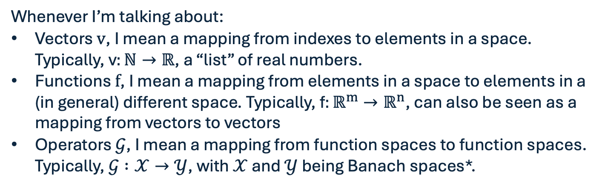
Definitions
Whenever I’m talking about:
Vectors $v$, I mean a mapping from indexes to elements in a space. Typically, v$:ℕ→ℝ$, a “list” of real numbers.
Functions $f$, I mean a mapping from elements in a space to elements in a (in general) different space. Typically, f$:ℝ^{m}→ℝ^{n}$, can also be seen as a mapping from vectors to vectors
Operators $𝒢$, I mean a mapping from function spaces to function spaces. Typically, $𝒢 :𝒳→𝒴$, with $𝒳$ and $𝒴$ being Banach spaces*.
*A fancy way of saying that my functions are well behaved.

Slide 11
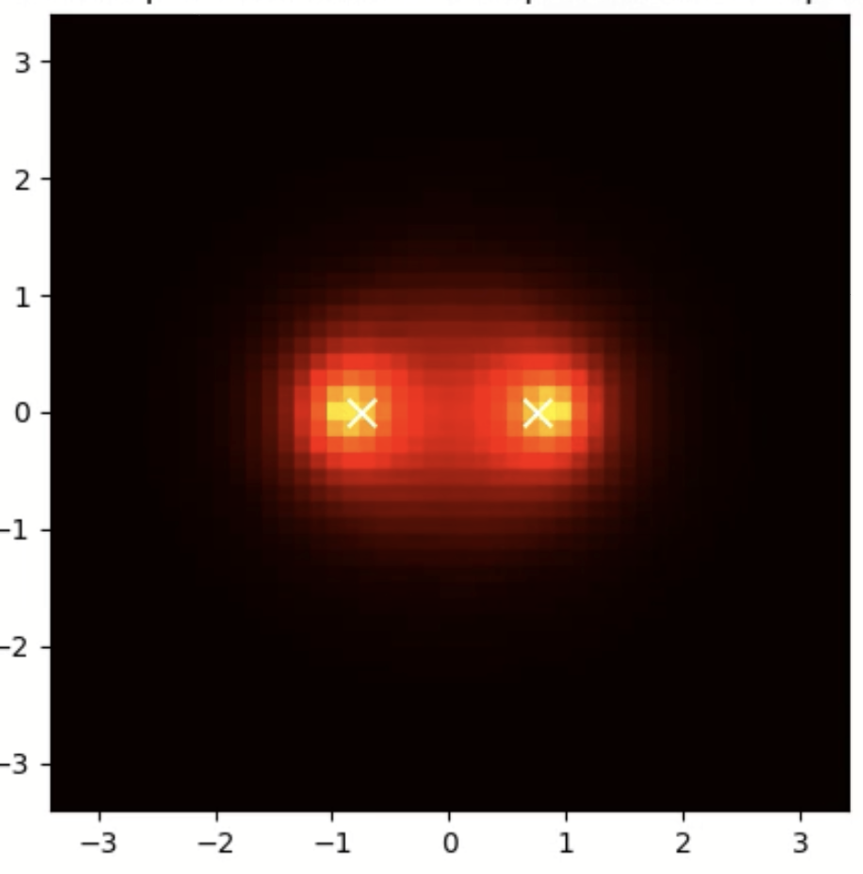
Definitions
Whenever I’m talking about:
Vectors $v$, I mean a mapping from indexes to elements in a space. Typically, v$:ℕ→ℝ$, a “list” of real numbers.
Functions $f$, I mean a mapping from elements in a space to elements in a (in general) different space. Typically, f$:ℝ^{m}→ℝ^{n}$, can also be seen as a mapping from vectors to vectors
Operators $𝒢$, I mean a mapping from function spaces to function spaces. Typically, $𝒢 :𝒳→𝒴$, with $𝒳$ and $𝒴$ being Banach spaces*.
*A fancy way of saying that my functions are well behaved.

Slide 12
Definitions
Whenever I’m talking about:
Vectors $v$, I mean a mapping from indexes to elements in a space. Typically, v$:ℕ→ℝ$, a “list” of real numbers.
Functions $f$, I mean a mapping from elements in a space to elements in a (in general) different space. Typically, f$:ℝ^{m}→ℝ^{n}$, can also be seen as a mapping from vectors to vectors
Operators $𝒢$, I mean a mapping from function spaces to function spaces. Typically, $𝒢 :𝒳→𝒴$, with $𝒳$ and $𝒴$ being Banach spaces*.
*A fancy way of saying that my functions are well behaved.

Slide 13
Key differences between Vectors and Functions
A vector is naturally discrete. Therefore, the input-output pair for functions is also naturally discrete.
A function is naturally continuous. Therefore, the input-output pair for operators is also naturally continuous.

Slide 14
Key differences between Vectors and Functions
A vector is naturally discrete. Therefore, the input-output pair for functions is also naturally discrete.
A function is naturally continuous. Therefore, the input-output pair for operators is also naturally continuous.
But we can only input lists (therefore, vectors) to computers, so why bother with functions?

Slide 15
Key differences between Vectors and Functions
A vector is naturally discrete. Therefore, the input-output pair for functions is also naturally discrete.
A function is naturally continuous. Therefore, the input-output pair for operators is also naturally continuous.
But we can only input lists (therefore, vectors) to computers, so why bother with functions? Because everything in the real world is a function!

Slide 16
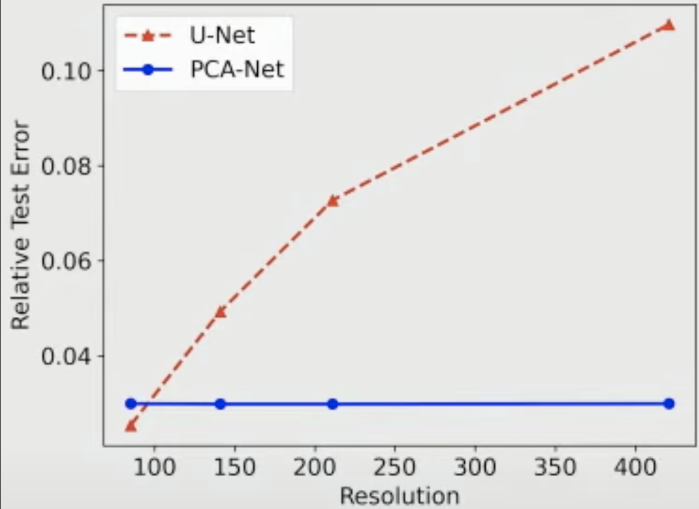
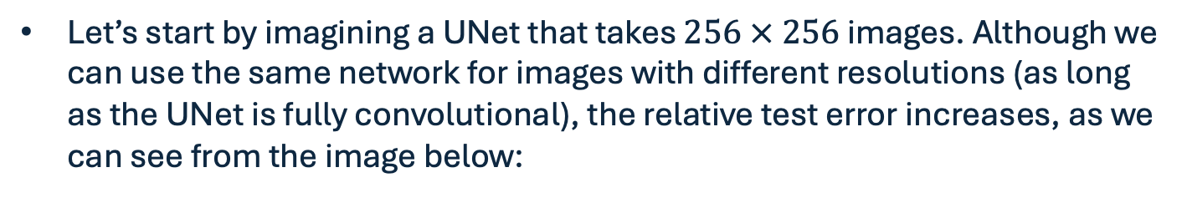
A key aspect of Operators
Let’s start by imagining a UNet that takes $256 × 256$ images. Although we can use the same network for images with different resolutions (as long as the UNet is fully convolutional), the relative test error increases, as we can see from the image below:

Slide 17
A key aspect of Operators
This basically happens because we’re not learning the underlying governing law (function) behind the images; we’re only learning the mapping from one image (vector) to another.

Slide 18
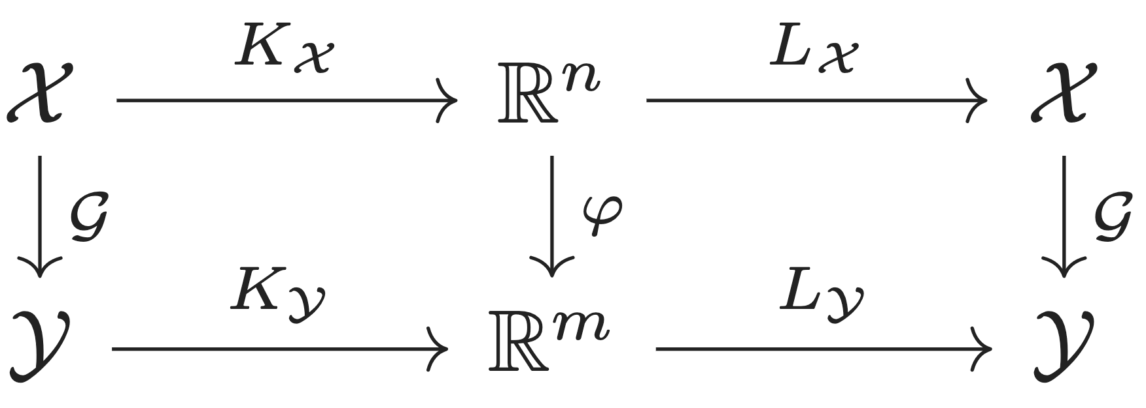
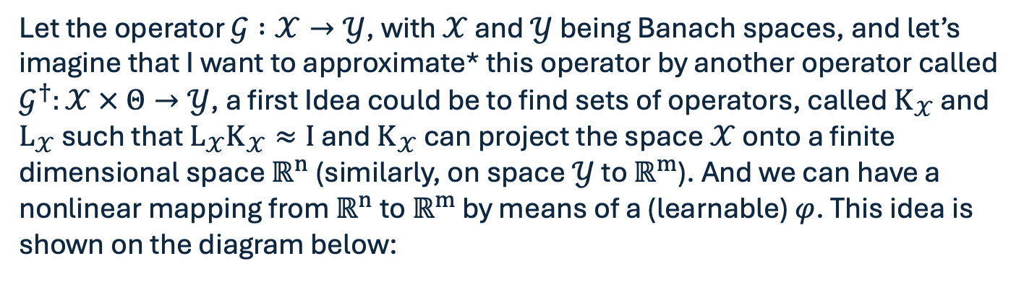
Initial Idea for Neural Operators
Let the operator $𝒢 :𝒳→𝒴$, with $𝒳$ and $𝒴$ being Banach spaces, and let’s imagine that I want to approximate* this operator by another operator called $𝒢^{†}:𝒳 × Θ→𝒴$, a first Idea could be to find sets of operators, called $K_{𝒳}$ and $L_{𝒳}$ such that $L_{𝒳}K_{𝒳}≈I$ and $K_{𝒳}$ can project the space $𝒳$ onto a finite dimensional space $ℝ^{n}$(similarly, on space $𝒴$ to $ℝ^{m}$). And we can have a nonlinear mapping from $ℝ^{n}$to $ℝ^{m}$ by means of a (learnable) $φ$. This idea is shown on the diagram below:

Slide 19
Initial Idea for Neural Operators
Let the operator $𝒢 :𝒳→𝒴$, with $𝒳$ and $𝒴$ being Banach spaces, and let’s imagine that I want to approximate* this operator by another operator called $𝒢^{†}:𝒳 × Θ→𝒴$, a first Idea could be to find sets of operators, called $K_{𝒳}$ and $L_{𝒳}$ such that $L_{𝒳}K_{𝒳}≈I$ and $K_{𝒳}$ can project the space $𝒳$ onto a finite dimensional space $ℝ^{n}$(similarly, on space $𝒴$ to $ℝ^{m}$). And we can have a nonlinear mapping from $ℝ^{n}$to $ℝ^{m}$ by means of a (learnable) $φ$. This idea is shown on the diagram below:

Slide 20
Initial Idea for Neural Operators
Let the operator $𝒢 :𝒳→𝒴$, with $𝒳$ and $𝒴$ being Banach spaces, and let’s imagine that I want to approximate* this operator by another operator called $𝒢^{†}:𝒳 × Θ→𝒴$, a first Idea could be to find sets of operators, called $K_{𝒳}$ and $L_{𝒳}$ such that $L_{𝒳}K_{𝒳}≈I$ and $K_{𝒳}$ can project the space $𝒳$ onto a finite dimensional space $ℝ^{n}$(similarly, on space $𝒴$ to $ℝ^{m}$). And we can have a nonlinear mapping from $ℝ^{n}$to $ℝ^{m}$ by means of a (learnable) $φ$. This idea is shown on the diagram below:

Slide 21
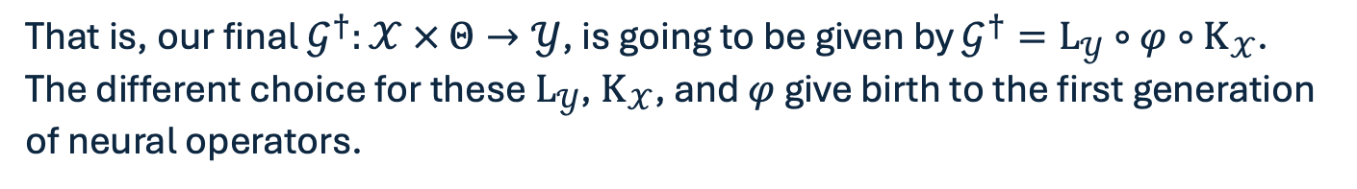
Initial Idea for Neural Operators
That is, our final $𝒢^{†}:𝒳 × Θ→𝒴$, is going to be given by $𝒢^{†}=L_{𝒴}∘{φ∘K}_{𝒳}$.
The different choice for these $L_{𝒴}$, $K_{𝒳}$, and $φ$ give birth to the first generation of neural operators.

Slide 22
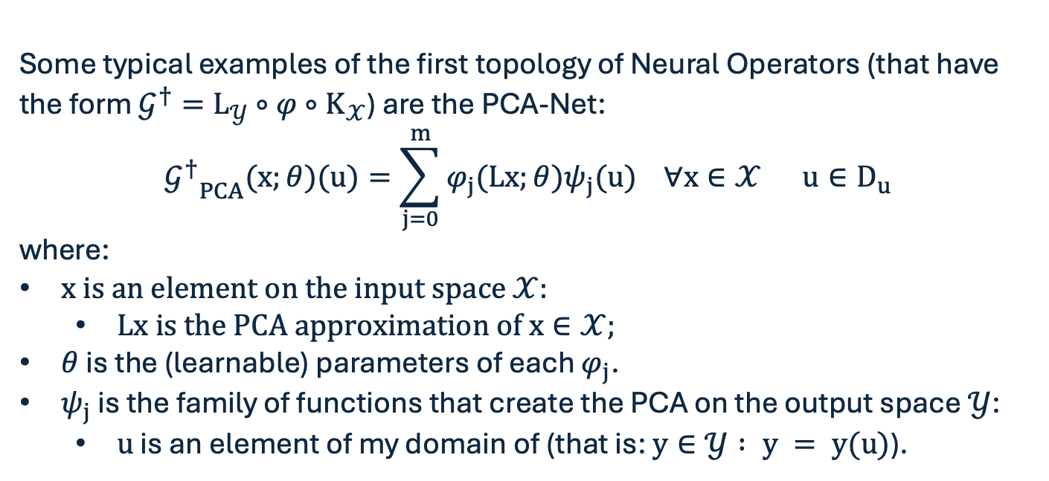
PCA-Net
Some typical examples of the first topology of Neural Operators (that have the form $𝒢^{†}=L_{𝒴}∘{φ∘K}_{𝒳}$) are the PCA-Net:
$${𝒢^{†}}_{PCA}(x;θ)(u)=\sum_{j=0}^{m}{φ_{j}(Lx;}θ)ψ_{j}(u) ∀x∈𝒳 u∈D_{u}$$
where:
$x$ is an element on the input space $𝒳:$
$Lx$ is the PCA approximation of $x∈𝒳$;
$θ$ is the (learnable) parameters of each $φ_{j}$.
$ψ_{j}$ is the family of functions that create the PCA on the output space $𝒴$:
$u$ is an element of my domain of (that is: $y∈𝒴 : y = y(u)$).

Slide 23
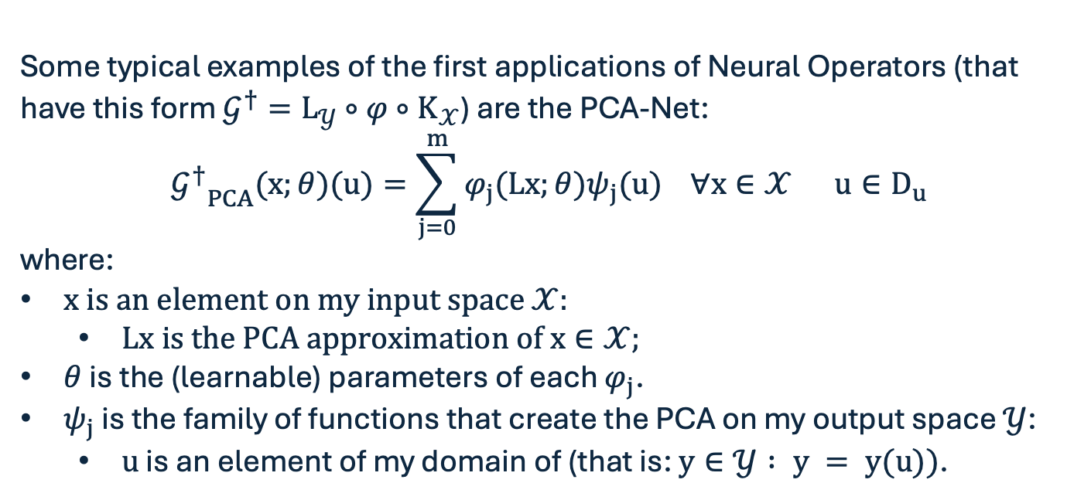
PCA-Net
Some typical examples of the first applications of Neural Operators (that have this form $𝒢^{†}=L_{𝒴}∘{φ∘K}_{𝒳}$) are the PCA-Net:
$${𝒢^{†}}_{PCA}(x;θ)(u)=\sum_{j=0}^{m}{φ_{j}(Lx;}θ)ψ_{j}(u) ∀x∈𝒳 u∈D_{u}$$
where:
$x$ is an element on my input space $𝒳:$
$Lx$ is the PCA approximation of $x∈𝒳$;
$θ$ is the (learnable) parameters of each $φ_{j}$.
$ψ_{j}$ is the family of functions that create the PCA on my output space $𝒴$:
$u$ is an element of my domain of (that is: $y∈𝒴 : y = y(u))$.

Slide 24
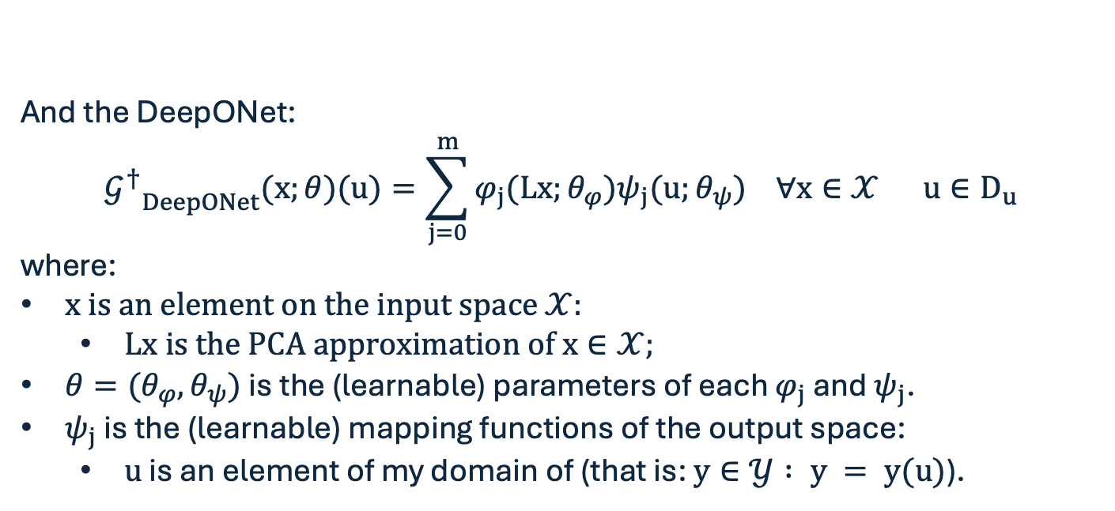
DeepONet
And the DeepONet:
$${𝒢^{†}}_{DeepONet}(x;θ)(u)=\sum_{j=0}^{m}{φ_{j}(Lx;}θ_{φ})ψ_{j}(u;θ_{ψ}) ∀x∈𝒳 u∈D_{u}$$
where:
$x$ is an element on the input space $𝒳:$
$Lx$ is the PCA approximation of $x∈𝒳$;
$θ=(θ_{φ},θ_{ψ})$ is the (learnable) parameters of each $φ_{j}$ and $ψ_{j}$.
$ψ_{j}$ is the (learnable) mapping functions of the output space:
$u$ is an element of my domain of (that is: $y∈𝒴 : y = y(u)$).

Slide 25
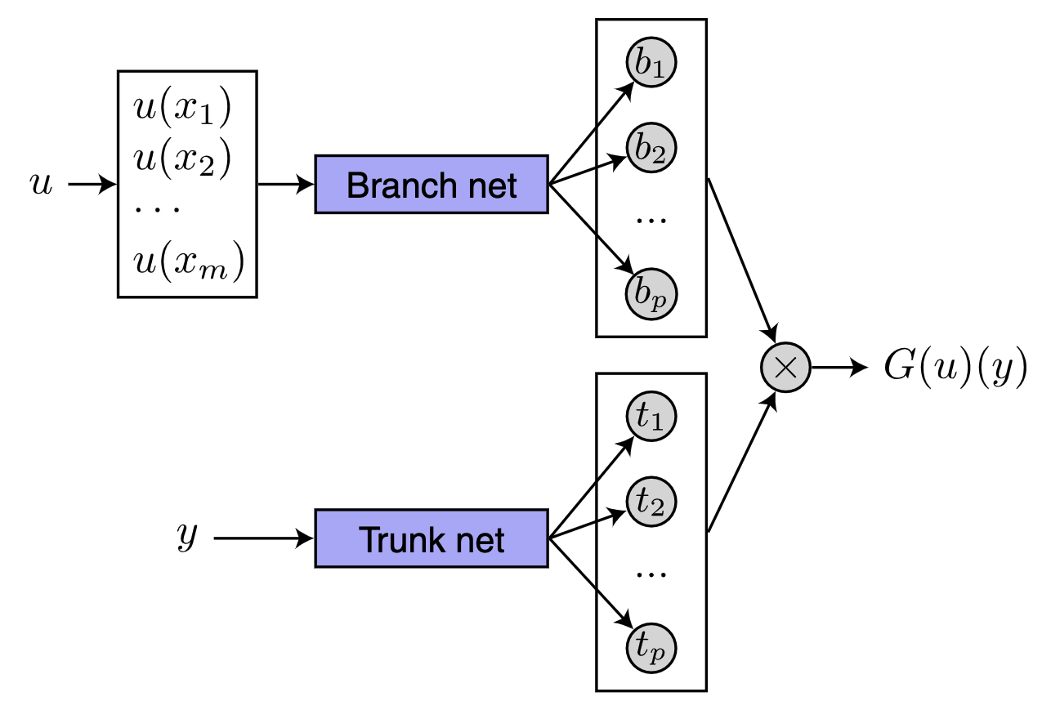
DeepONet
And the DeepONet:
$${𝒢^{†}}_{DeepONet}(x;θ)(u)=\sum_{j=0}^{m}{φ_{j}(Lx;}θ_{φ})ψ_{j}(u;θ_{ψ}) ∀x∈𝒳 u∈D_{u}$$
where:
$x$ is an element on the input space $𝒳:$
$Lx$ is the PCA approximation of $x∈𝒳$;
$θ=(θ_{φ},θ_{ψ})$ is the (learnable) parameters of each $φ_{j}$ and $ψ_{j}$.
$ψ_{j}$ is the (learnable) mapping functions of the output space:
$u$ is an element of my domain of (that is: $y∈𝒴 : y = y(u)$).

Slide 26
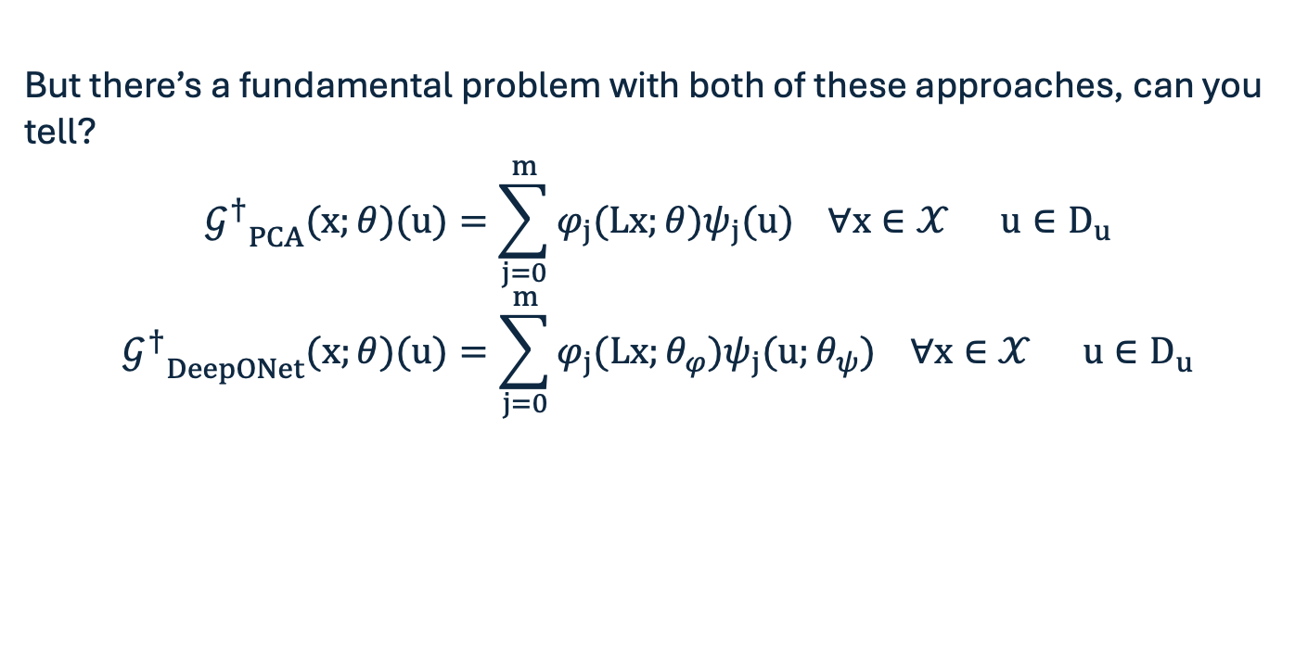
Fundamental “flaw”
But there’s a fundamental problem with both of these approaches, can you tell?
$${𝒢^{†}}_{PCA}(x;θ)(u)=\sum_{j=0}^{m}{φ_{j}(Lx;}θ)ψ_{j}(u) ∀x∈𝒳 u∈D_{u}$$
$${𝒢^{†}}_{DeepONet}(x;θ)(u)=\sum_{j=0}^{m}{φ_{j}(Lx;}θ_{φ})ψ_{j}(u;θ_{ψ}) ∀x∈𝒳 u∈D_{u}$$

Slide 27
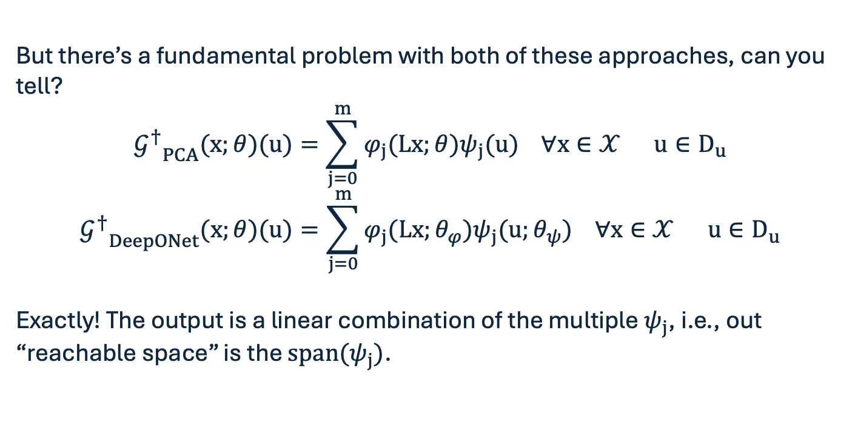
Fundamental “flaw”
But there’s a fundamental problem with both of these approaches, can you tell?
$${𝒢^{†}}_{PCA}(x;θ)(u)=\sum_{j=0}^{m}{φ_{j}(Lx;}θ)ψ_{j}(u) ∀x∈𝒳 u∈D_{u}$$
$${𝒢^{†}}_{DeepONet}(x;θ)(u)=\sum_{j=0}^{m}{φ_{j}(Lx;}θ_{φ})ψ_{j}(u;θ_{ψ}) ∀x∈𝒳 u∈D_{u}$$
Exactly! The output is a linear combination of the multiple $ψ_{j}$, i.e., out “reachable space” is the ${span(ψ}_{j})$.

Slide 28
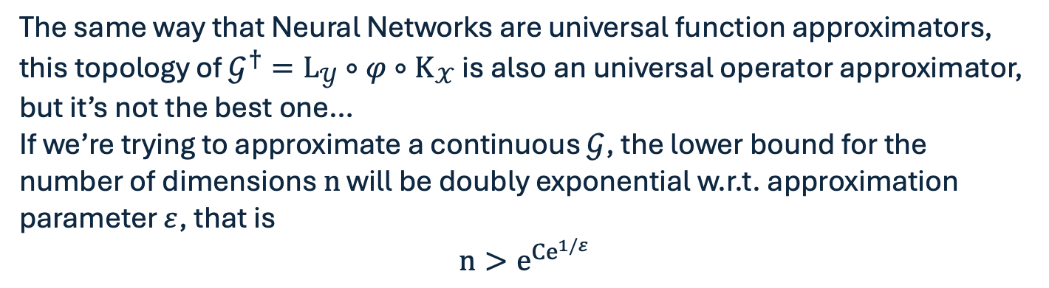
UAT for Neural Operators
The same way that Neural Networks are universal function approximators, this topology of $𝒢^{†}=L_{𝒴}∘{φ∘K}_{𝒳}$ is also an universal operator approximator, but it’s not the best one…
If we’re trying to approximate a continuous $𝒢$, the lower bound for the number of dimensions $n$ will be doubly exponential w.r.t. approximation parameter $ε$, that is
$$n>e^{{Ce}^{1/ε}}$$

Slide 29
10-minute break!
Notes:
What the AI will do

Slide 30
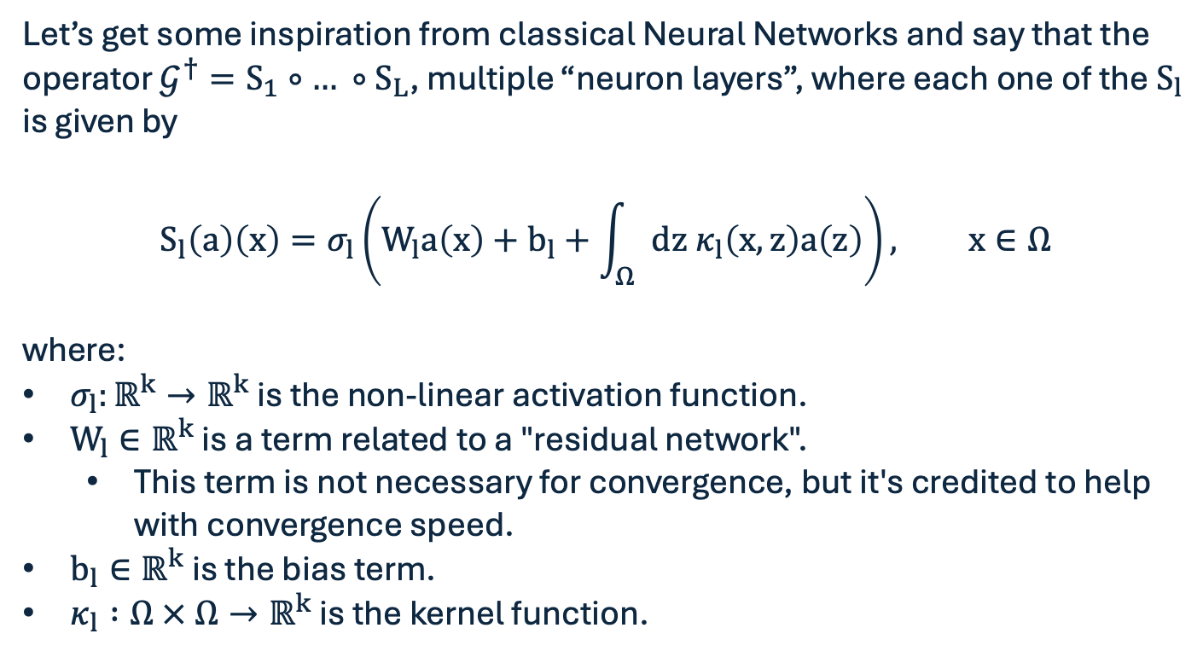
“Second generation” of Neural Operators
Let’s get some inspiration from classical Neural Networks and say that the operator $𝒢^{†}=S_{1}∘{… ∘S}_{L}$, multiple “neuron layers”, where each one of the $S_{l}$ is given by
$$S_{l}\left(a\right)\left(x\right)=σ_{l}\left(W_{l}a\left(x\right)+b_{l}+\int_{Ω}{dz{ κ}_{l}\left(x,z\right)a\left(z\right)}\right), x∈Ω$$
where:
$σ_{l}:ℝ^{k}→ℝ^{k}$ is the non-linear activation function.
$W_{l}∈ℝ^{k}$ is a term related to a "residual network".
This term is not necessary for convergence, but it's credited to help with convergence speed.
$b_{l}∈ℝ^{k}$ is the bias term.
$κ_{l} :Ω × Ω→ℝ^{k}$ is the kernel function.

Slide 31
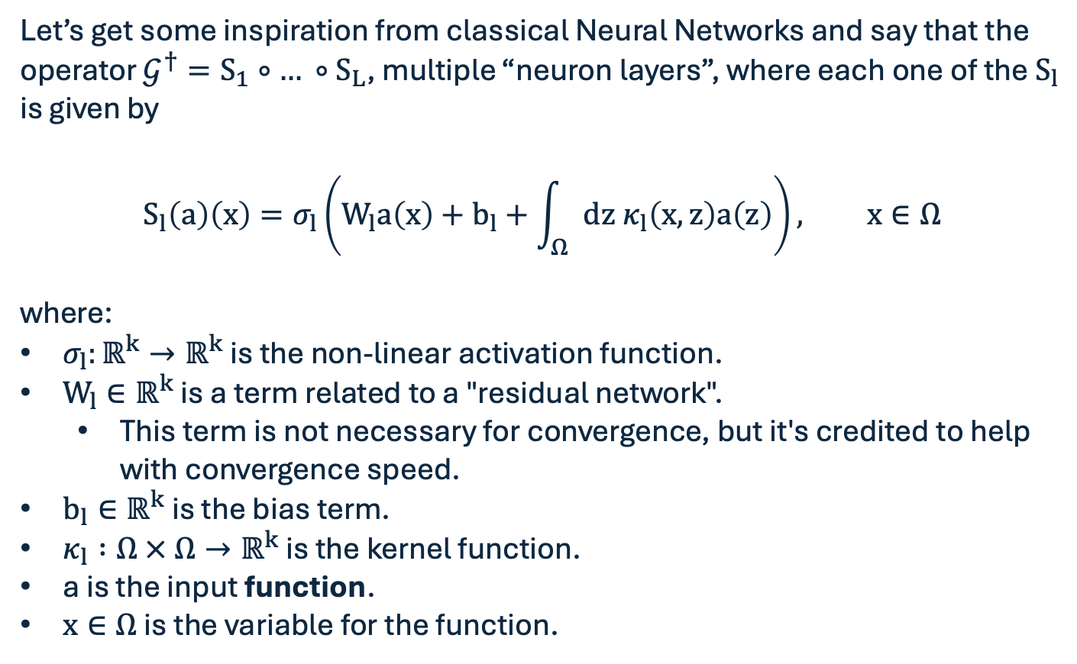
“Second generation” of Neural Operators
Let’s get some inspiration from classical Neural Networks and say that the operator $𝒢^{†}=S_{1}∘{… ∘S}_{L}$, multiple “neuron layers”, where each one of the $S_{l}$ is given by
$$S_{l}\left(a\right)\left(x\right)=σ_{l}\left(W_{l}a\left(x\right)+b_{l}+\int_{Ω}{dz{ κ}_{l}\left(x,z\right)a\left(z\right)}\right), x∈Ω$$
where:
$σ_{l}:ℝ^{k}→ℝ^{k}$ is the non-linear activation function.
$W_{l}∈ℝ^{k}$ is a term related to a "residual network".
This term is not necessary for convergence, but it's credited to help with convergence speed.
$b_{l}∈ℝ^{k}$ is the bias term.
$κ_{l} :Ω × Ω→ℝ^{k}$ is the kernel function.
a is the input function.
$x∈Ω$ is the variable for the function.

Slide 32
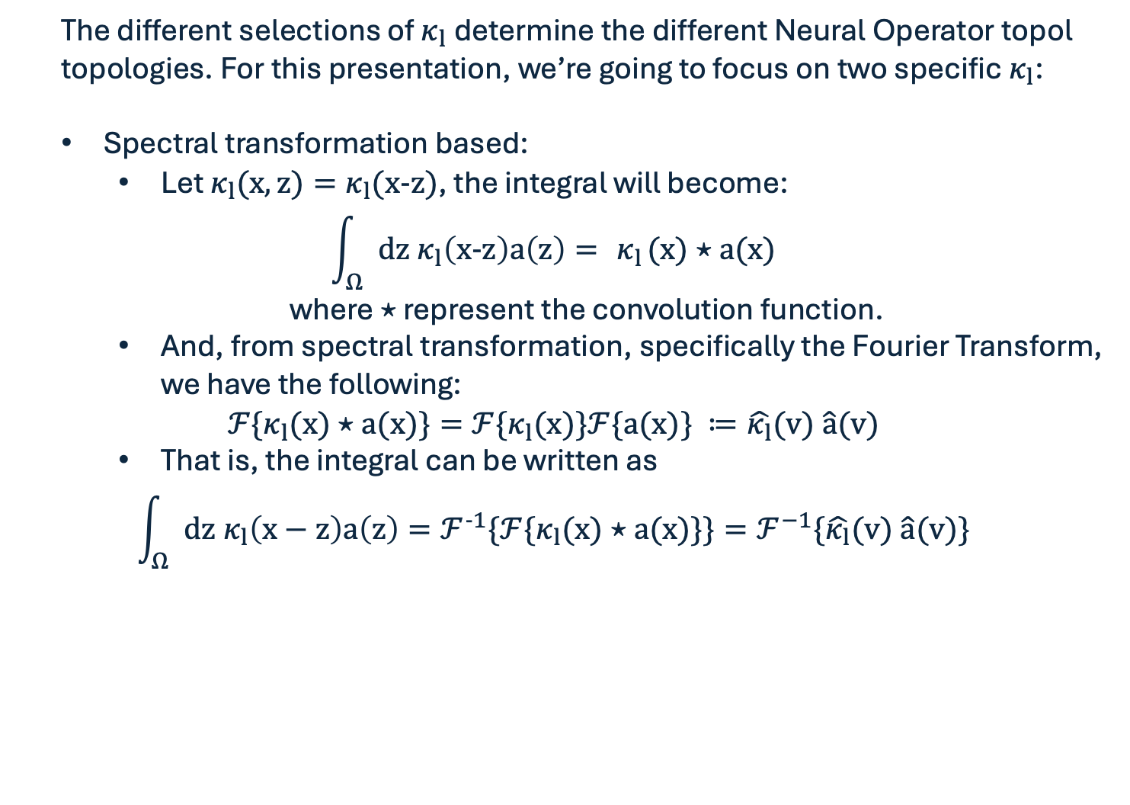
S$pectral κ_{l}$
The different selections of $κ_{l}$determine the different Neural Operator topol topologies. For this presentation, we’re going to focus on two specific $κ_{l}$:
Spectral transformation based:
Let $κ_{l}(x,z)=κ_{l}(x-z)$, the integral will become:
$$\int_{Ω}{dz{ κ}_{l}\left(x-z\right)a\left(z\right)}={ κ}_{l}(x)⋆a(x)$$
where $⋆$ represent the convolution function.
And, from spectral transformation, specifically the Fourier Transform, we have the following:
$$ℱ\{κ_{l}(x)⋆a(x)\}=ℱ\{κ_{l}(x)\}ℱ\{a(x)\} ≔\hat{κ_{l}}(v) \hat{a}(v)$$
That is, the integral can be written as
$$\int_{Ω}{dz{ κ}_{l}\left(x−z\right)a\left(z\right)}=ℱ^{-1}\{ℱ\{κ_{l}(x)⋆a(x)\}\}=ℱ^{−1}\{\hat{κ_{l}}(v) \hat{a}(v)\}$$

Slide 33
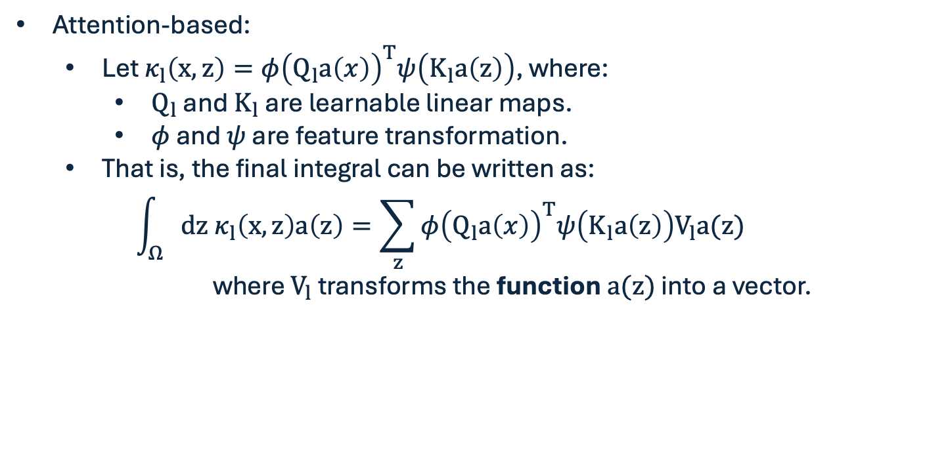
A$ttention-based κ_{l}$
Attention-based:
Let $κ_{l}\left(x,z\right)=φ{\left(Q_{l}a\left(x\right)\right)}^{T}ψ\left(K_{l}a\left(z\right)\right)$, where:
$Q_{l}$ and $K_{l}$ are learnable linear maps.
$φ$ and $ψ$ are feature transformation.
That is, the final integral can be written as:
$$\int_{Ω}{dz{ κ}_{l}\left(x,z\right)a\left(z\right)=\sum_{z}{φ{\left(Q_{l}a\left(x\right)\right)}^{T}ψ\left(K_{l}a\left(z\right)\right)V_{l}a(z)}}$$
where $V_{l}$ transforms the function $a(z)$ into a vector.

Slide 34
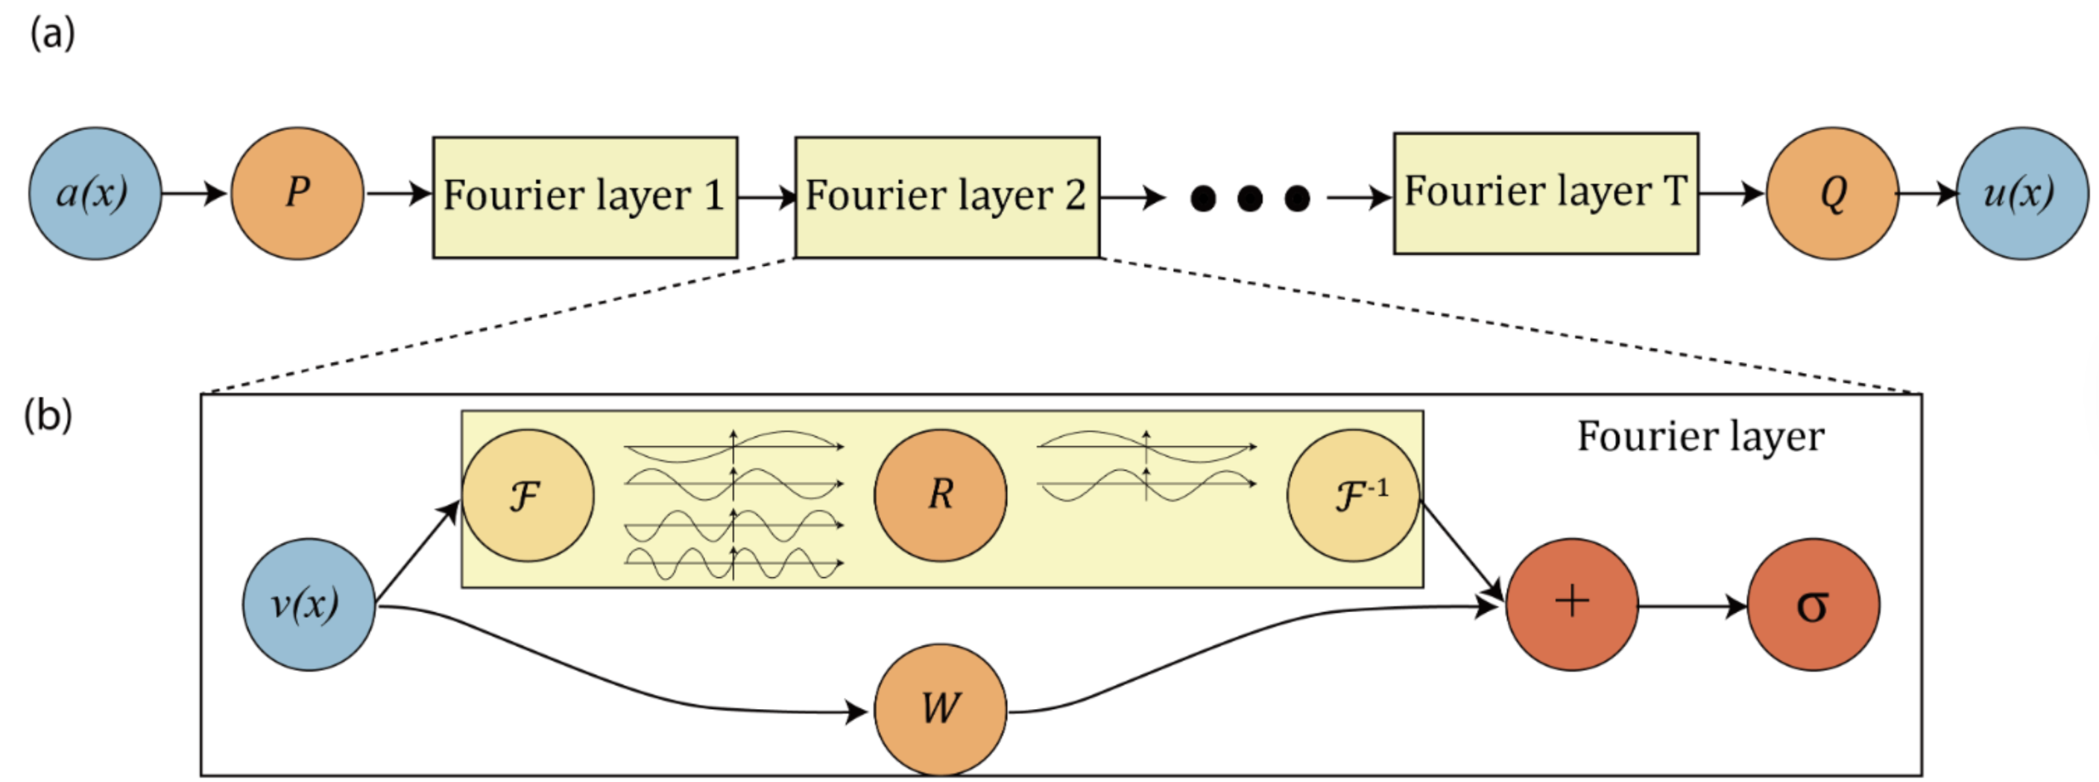
Fourier Neural Operator

Slide 35
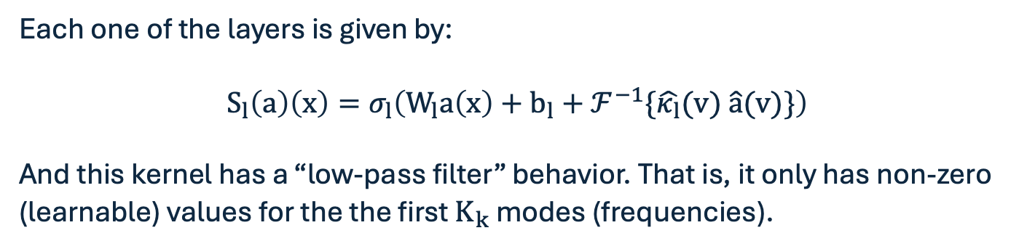
Fourier Neural Operator
Each one of the layers is given by:
$$S_{l}\left(a\right)\left(x\right)=σ_{l}\left(W_{l}a\left(x\right)+b_{l}+ℱ^{−1}\{\hat{κ_{l}}(v) \hat{a}(v)\}\right)$$
And this kernel has a “low-pass filter” behavior. That is, it only has non-zero (learnable) values for the the first $K_{k}$ modes (frequencies).

Slide 36
Fourier Neural Operator
To the code!

Slide 37
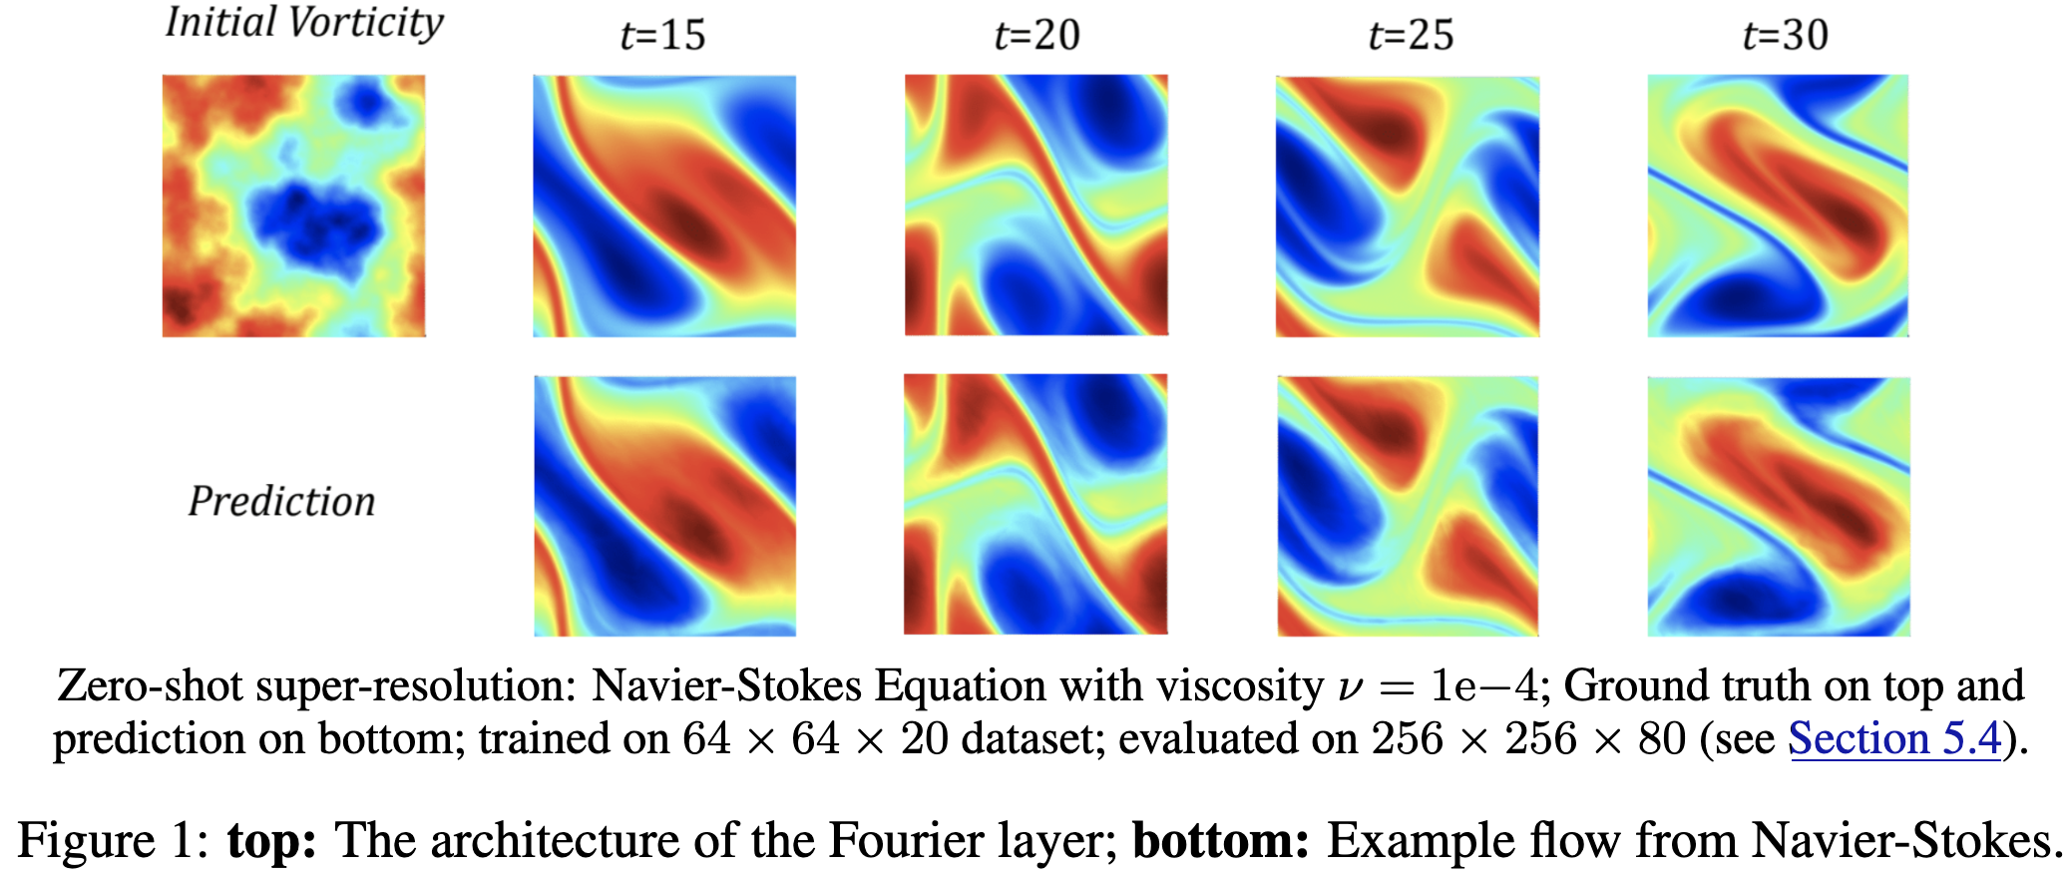
Fourier Neural Operator - Zero-shot resolution in time

Slide 38
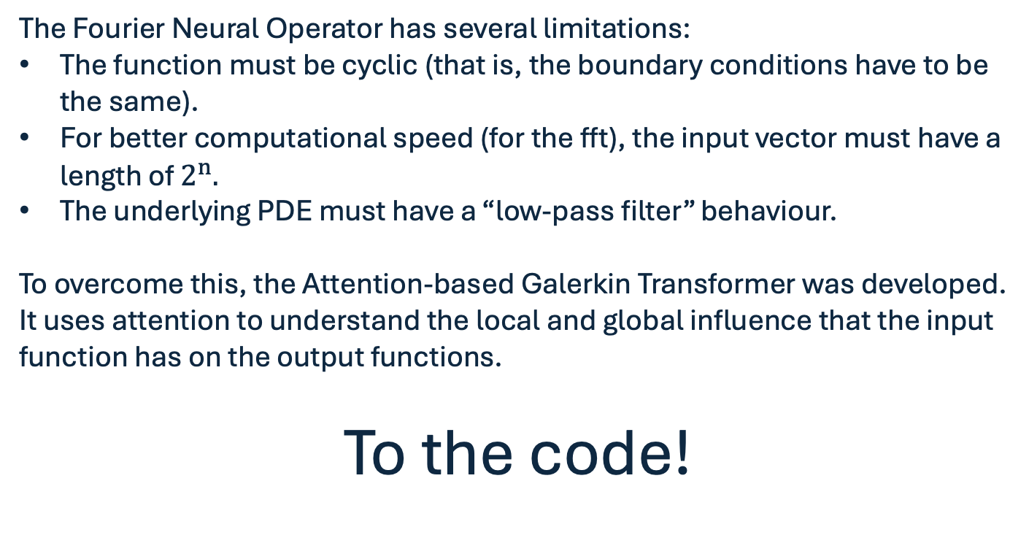
Fourier limitations and the Galerkin Transformer
The Fourier Neural Operator has several limitations:
The function must be cyclic (that is, the boundary conditions have to be the same).
For better computational speed (for the fft), the input vector must have a length of $2^{n}.$
The underlying PDE must have a “low-pass filter” behaviour.
To overcome this, the Attention-based Galerkin Transformer was developed.
It uses attention to understand the local and global influence that the input function has on the output functions.
To the code!

Slide 39
Potential improvements
All the topologies shown in this presentation are so-called “PDE agnostic”, i.e., they only learn based on data.
There have been some efforts to create PINN versions of these topologies, starting with the PINN PCA-Net.
On a paper published less than a month ago (Sept 9th), they were able to:
“Quantitatively, the end-to-end pipeline time—including PCA computation, training, and inference—was reduced by a factor of approximately 3.7–4× compared to the baseline global PCA pipeline.”

Slide 40
Large-scale Surrogates
Some practical uses of Neural Operators

Slide 41
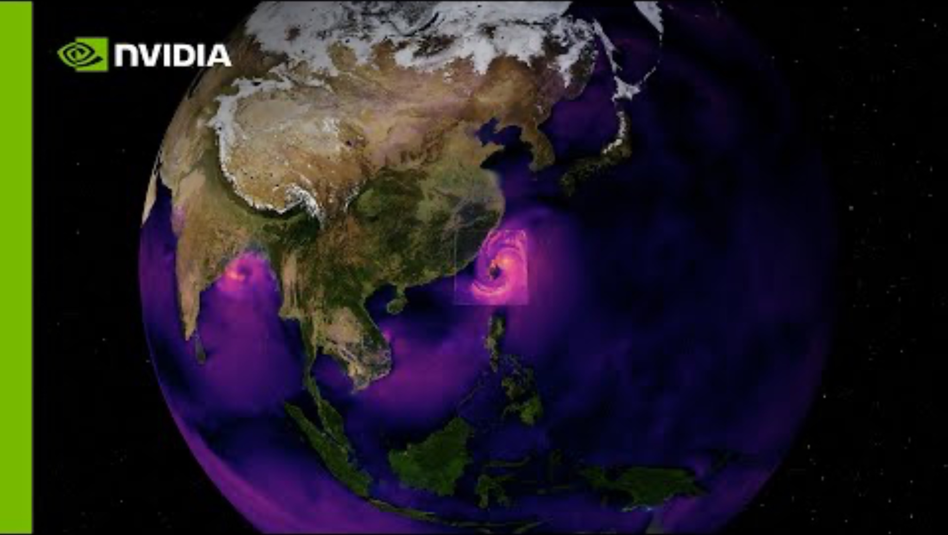
Superresolution in practice

Slide 42
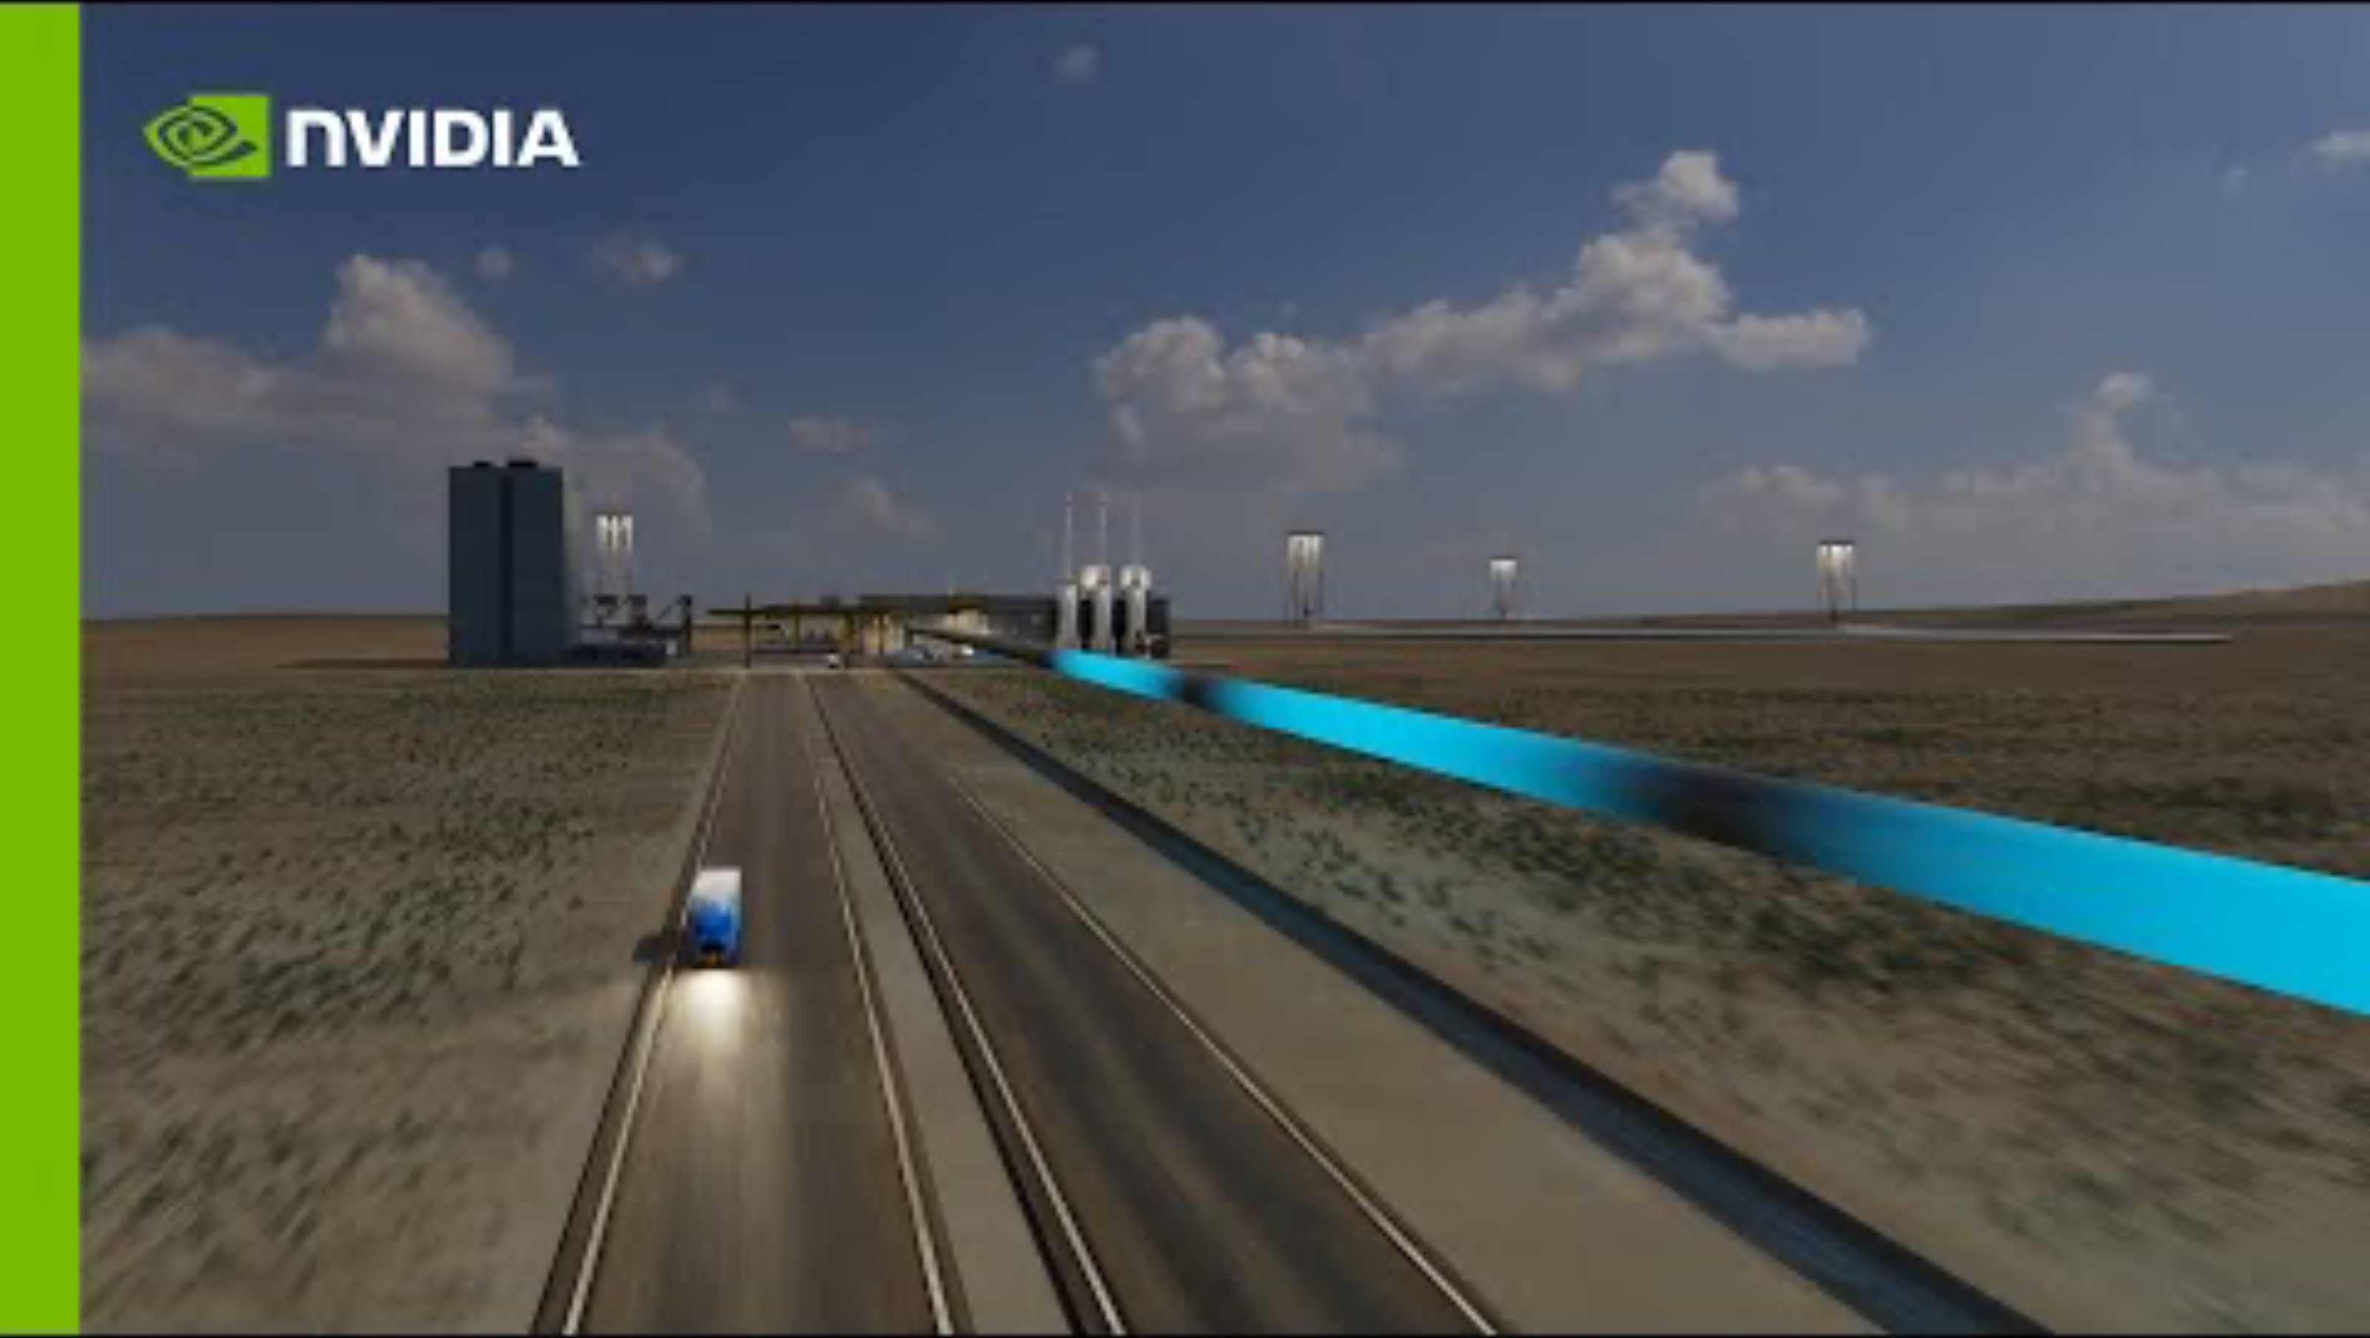
Neural Operators being used with “Optimization”

Slide 43
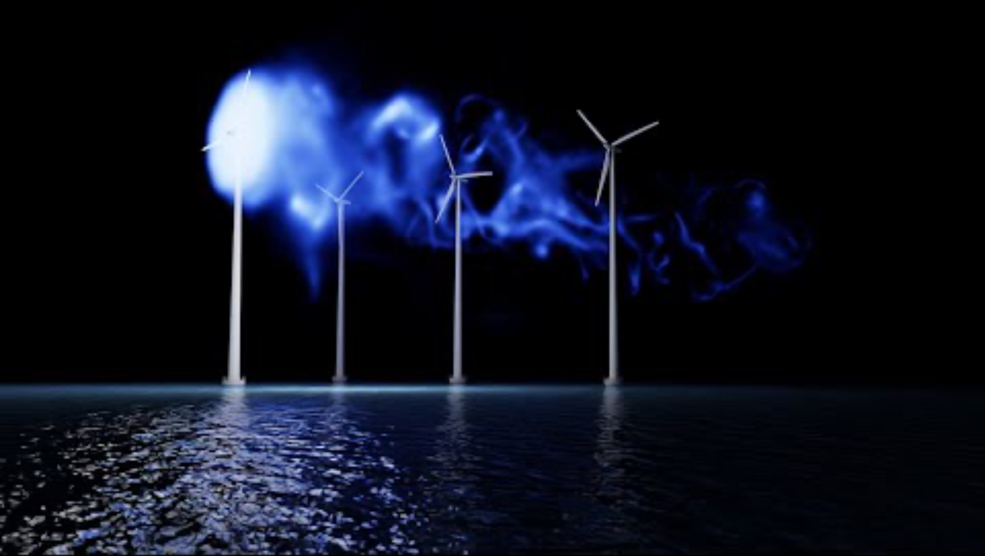
Neural Operators being used with Optimization

Slide 44
Next weeks presentation
Next week, we’re going to have Dr. Charlelie Laurent presenting about Graphic Neural Operators and how to integrate control with them.
Don’t miss it!

Slide 45
Thank you!
Any questions?
psilva34@gatech.edu
Notes:
What the AI will do

